Slide 1

IIITD Marketplace
Group 14 Project 4
Manveet Singh
Mann Nariya
Manya Agrawal
Maulik Mahey
Mann Sharma

Slide 2
PROBLEM STATEMENT
SOLUTION STATEMENT
A marketplace platform for college students can be a great way to help students sell products and services such as old books and tutoring. This platform can help students make extra money by selling items they no longer need or offering their skills as a tutor. Additionally, the platform can make it easier for students to find and purchase items or services they need at a lower cost than they would find elsewhere. This can be particularly beneficial for students on a tight budget. Furthermore, it can also be a great way for students to connect with one another and build a sense of community within the college. This can be a great resource for both buyers and sellers, making it a win-win for all parties involved.
College students face difficulties in finding affordable resources, and disposing of their unwanted possessions. This creates a gap in the market for a platform that connects students and facilitates the buying and selling of products and services, such as old books and tutoring, within the college community

Slide 3
Tutoring:
Access to a variety of subject matter experts, to accommodate different learning styles and subject needs.
Flexible scheduling options, to accommodate students' busy schedules One-on-one or small group instruction, to provide personalized attention and support
REQUIREMENT GATHERING
Hostel Services:
Safe and secure accommodation, to provide peace of mind for students and their families
Affordable pricing options, to make the service accessible to a wide range of students

Slide 4
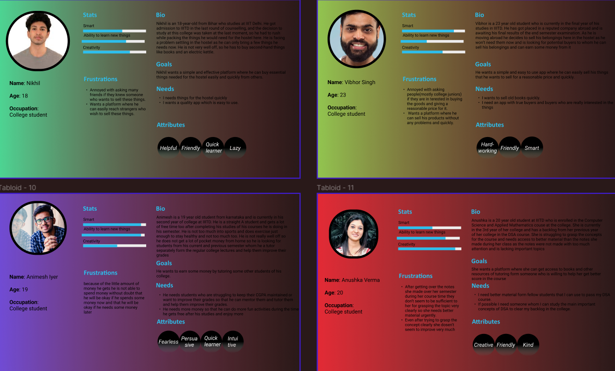
PERSONAS

Slide 5
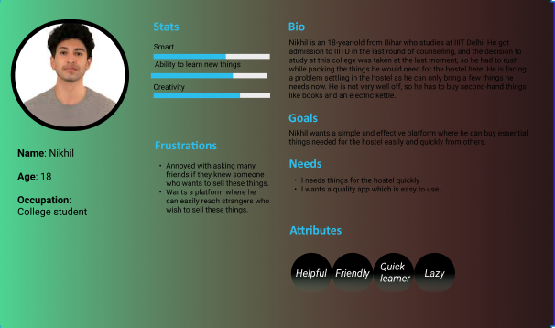
PERSONAS

Slide 6
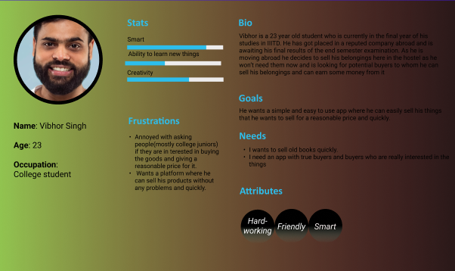
PERSONAS

Slide 7
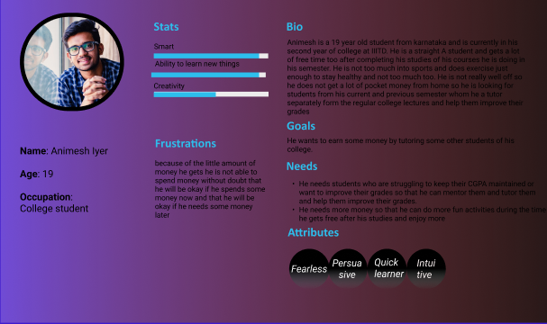
PERSONAS

Slide 8
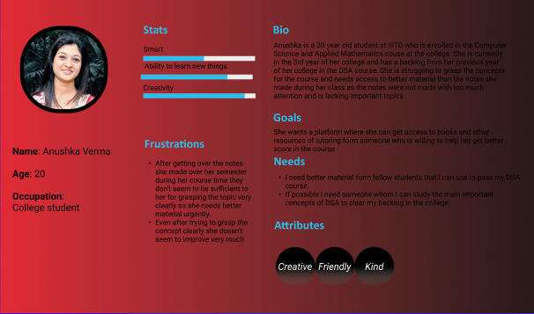
PERSONAS

Slide 9
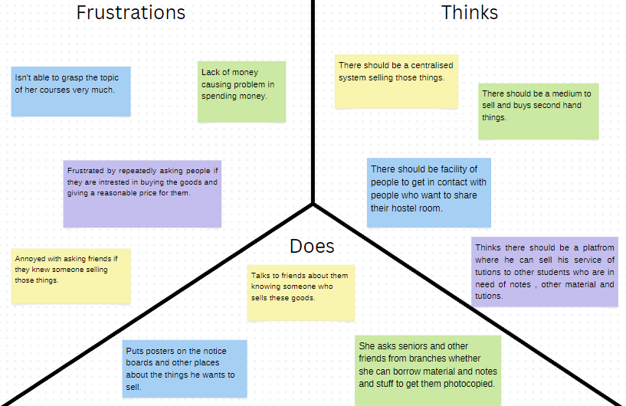
EMPATHY MAPPING

Slide 10

USERS
IIITD MARKETPLACE
USERS
Housing facilities near college
CASE DIAGRAM
Hostlers
Triple sharing agreements
TAKER
Near by students
Good quality notes
Tutorship programs/peer learning
Seniors/ Studious students
PROVIDER

Slide 11
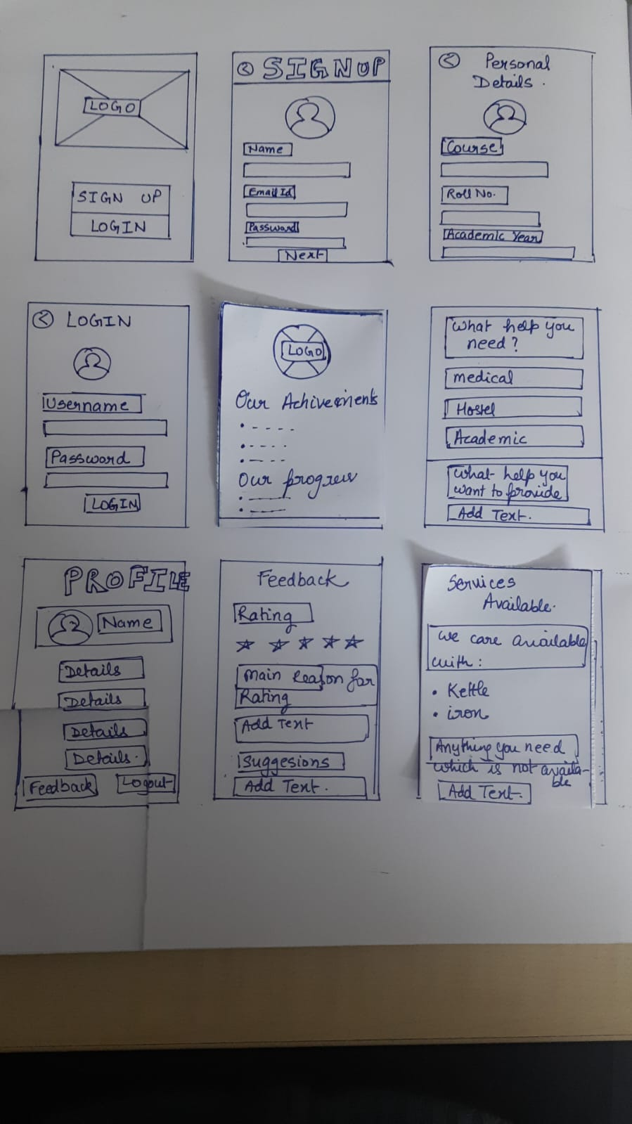
MAKING OF LOFI PROTOTYPE

Slide 12
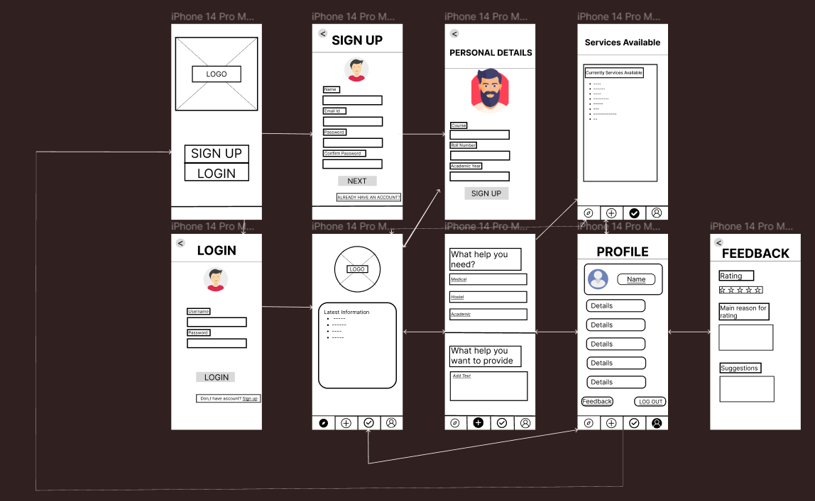
FINAL LOFI PROTOTYPE
FIGMA LINK👇
https://www.figma.com/file/vZuNYQPj0072sql8pfSCgR/HCI-PROJECT?node-id=0%3A1&t=pXTVRNDBjXHucI47-0

Slide 13
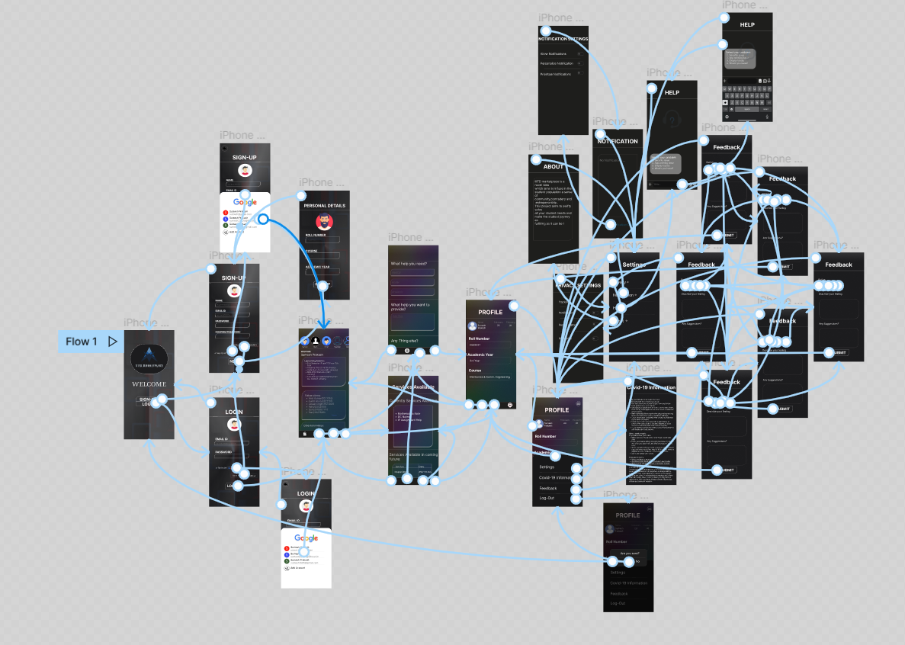
HIFI PROTOTYPE
FIGMA LINK👇
https://www.figma.com/file/6ZCcqFM1IBUpRkF4y061m2/hci-hifi?t=pXTVRNDBjXHucI47-1

Slide 14
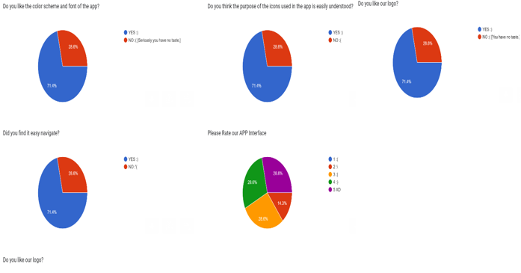
USER TESTING &
EVALUATION

Slide 15
We are still learning from each other. This project has actually shown the practical learning of UI/UX. We are currently satisfied with our project, but there is a long way to go. We are still learning new things and trying to cover all the aspects of Human Centered Design.
LEARNING &
REFLECTIONS

